Slide 1

Exam AZ-400: Microsoft Azure DevOps Solutions Crash Course
Tim Warner @TechTrainerTim

Slide 2


Tim Warner
Based in Nashville, TN, US
MCT, MVP
Twitter: @TechTrainerTim
Badge: TechTrainerTim.com

Slide 3
Session 1 of 2 Learning Goals
Develop a SRE strategy (5-10%)
Develop a security & compliance plan (10-15%)
Manage source control (10-15%)
Develop an instrumentation strategy (5-10%)

Slide 4
Session 2 of 2 Learning Goals
Define and implement CI pipelines (20-25%)
Define and implement a CD/RM strategy (10-15%)
Facilitate communication & collaboration (10-15%)
AZ-400 exam tips & tricks throughout!

Slide 5
Course Materials
timw.info/az400

Slide 6
Setting Expectations
This is a six-hour "crash course"
Please plan to review these materials more than once
Five-minute break at midpoint
Please ask/answer questions and provide feedback in the Q/A panel, not the group chat
I'll post outstanding questions/answers to my Twitter feed: @TechTrainerTim

Slide 7

Session Recordings

Slide 8
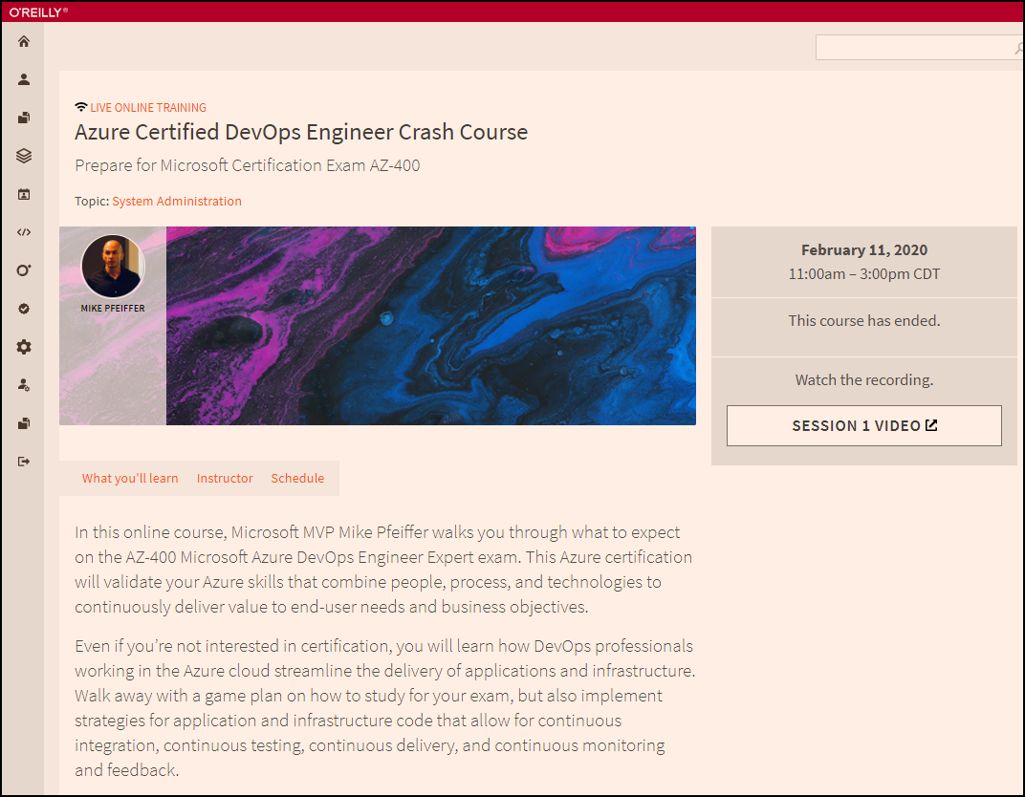
Session Recordings

Slide 9

Session Recordings

Slide 10
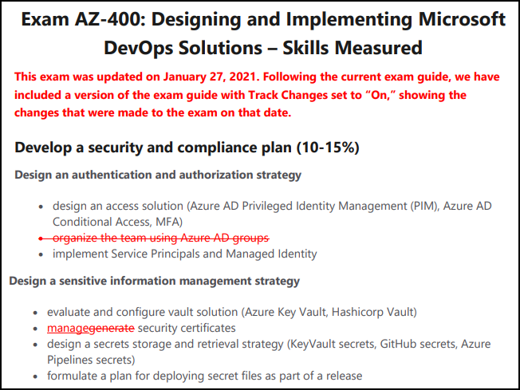
Exam AZ-400 Latest Updates

Slide 11
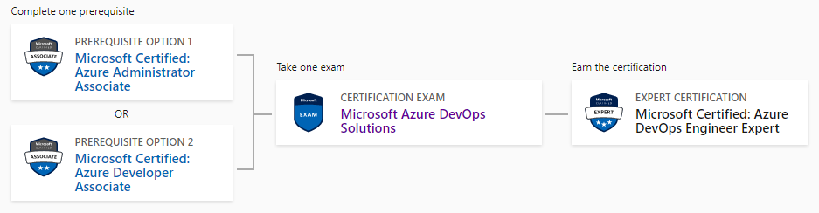
DevOps Engineer Expert Certification
AZ-104
AZ-400
AZ-204

Slide 12
Tim's Suggested Certification Strategy
Clear Exam AZ-104, Microsoft Azure Administrator, first
You need those core infrastructure skills
JSON, PowerShell
Monitoring
Then clear Exam AZ-400
AZ-400 is about development principles, not programming
This course gives you the dev foundations
You need to already have the ops foundations

Slide 13
Develop an SRE Strategy

Slide 14
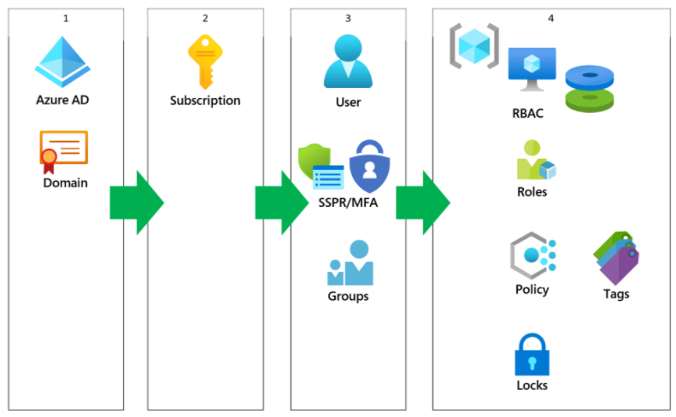
Azure AD Identity

Slide 15
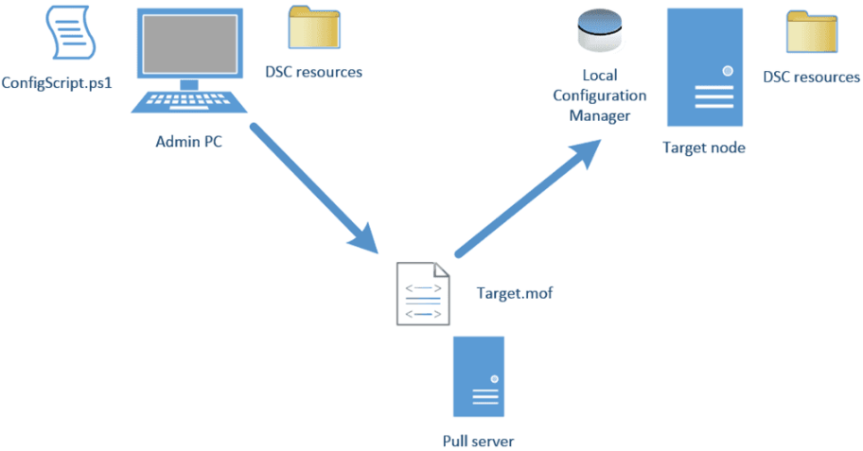
Azure Automation DSC

Slide 16
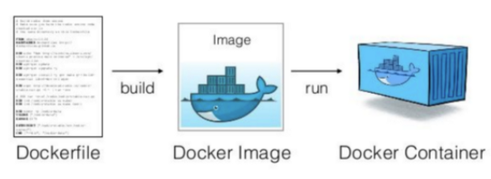
Docker Container Development Process

Slide 17
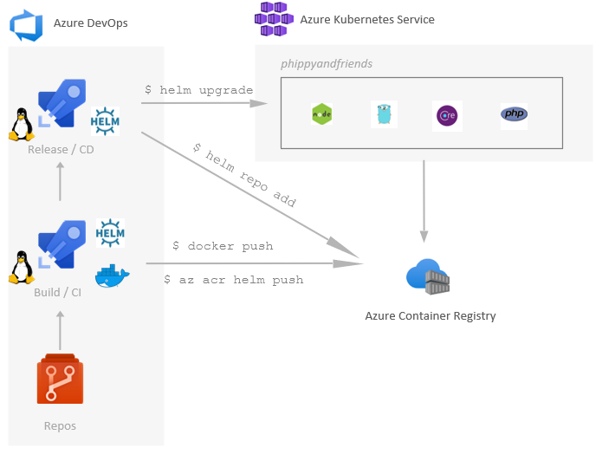
Helm, ACR, and AKS

Slide 18
Develop a Security and Compliance Plan

Slide 19
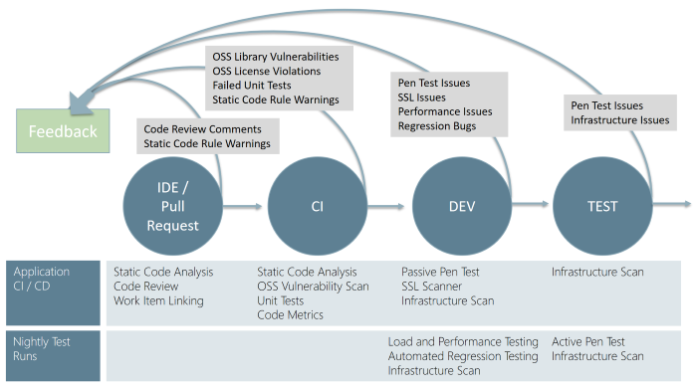
Continuous Security Validation

Slide 20
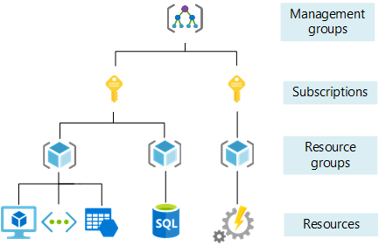
Azure Management Scopes

Slide 21
Manage Source Control

Slide 22
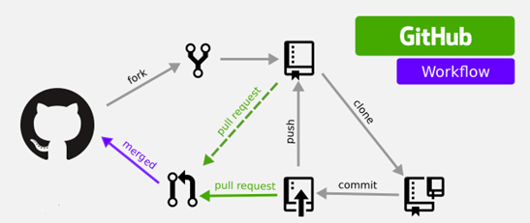
GitHub Workflow

Slide 23
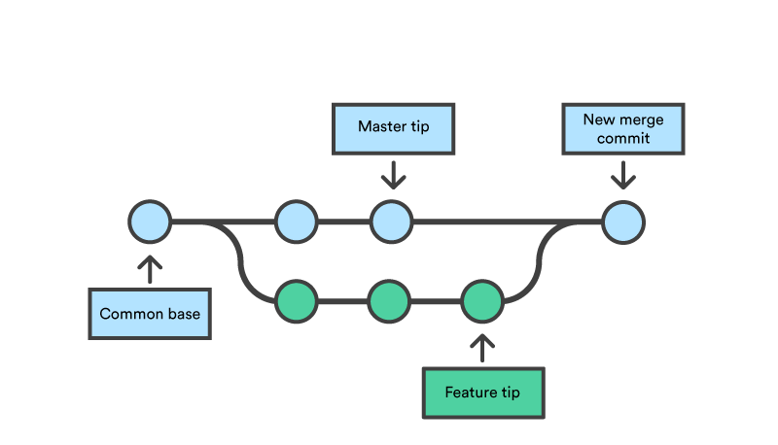
Feature Branching and Merging

Slide 24
Thank you!
Course materials: timw.info/az400
Twitter: @TechTrainerTim
Work: timw.info/ps
Web: TechTrainerTim.com

Slide 25
Exam AZ-400: Microsoft Azure DevOps Solutions Crash Course
Tim Warner @TechTrainerTim

Slide 26
Session 2 of 2 Learning Goals
Sweep up shavings from yesterday
Bunch o' stuff! :)
Define and implement CI/CD pipelines
Define and implement dependency management
Azure Artifacts
Facilitate communication & collaboration
Test Plans

Slide 27
Course Materials
timw.info/az400

Slide 28
Sweeping Up the Shavings

Slide 29
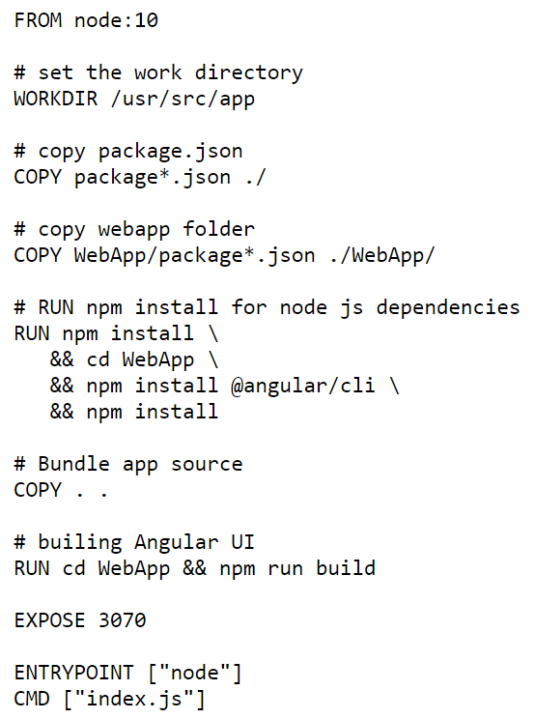
Single-Stage Dockerfile

Slide 30
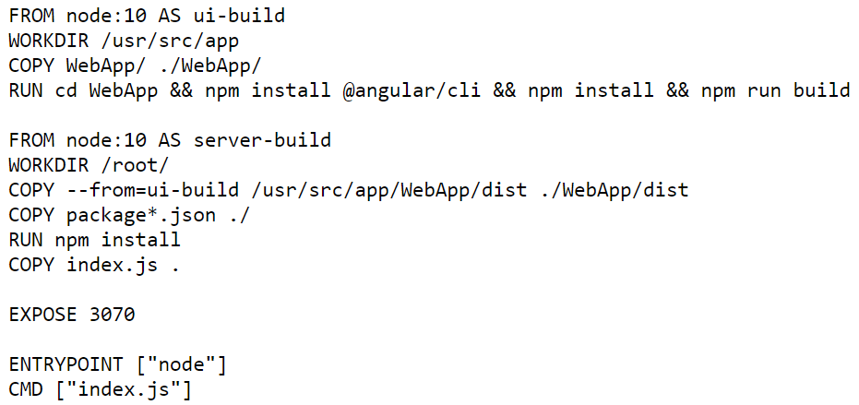
Multi-Stage Dockerfile

Slide 31
Helm, ACR, and AKS

Slide 32
Continuous Security Validation

Slide 33
Azure Pipelines

Slide 34




DevOps Reading List

Slide 35
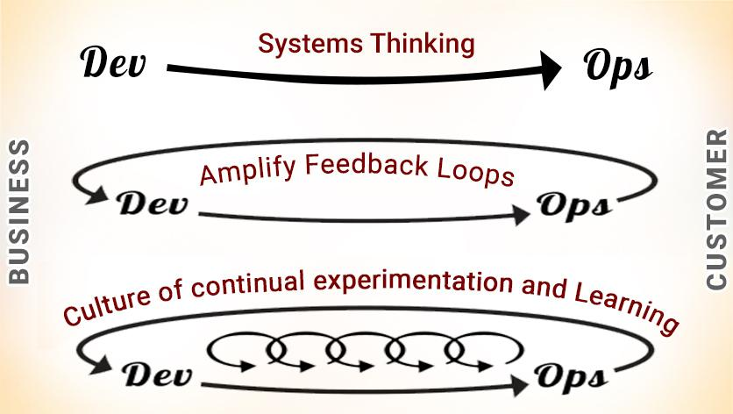
DevOps - The Three Ways

Slide 36
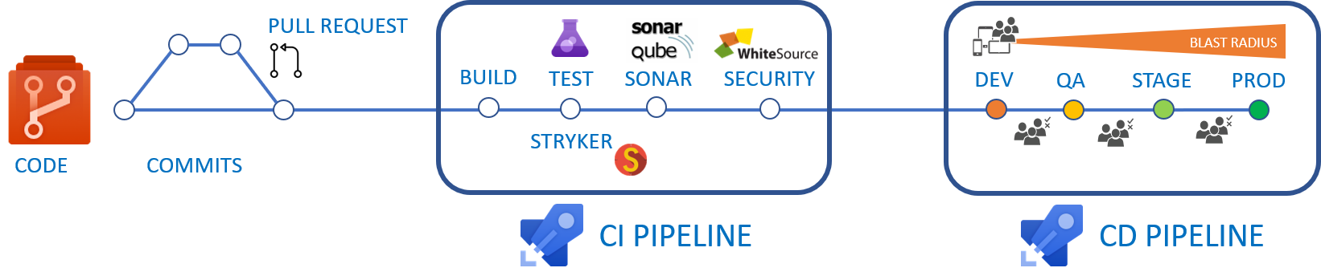
CI/CD Pipelines

Slide 37
Formats 'n' Languages
Data formats
JSON
YAML
Languages
Azure PowerShell
Azure CLI
Dockerfile
KQL

Slide 38
Your Marching Orders
Register for the exam ASAP (get it on your calendar!)
Purchase a quality practice exam
Work through AzureDevOpsLabs.com if you can
A Cloud Guru, Cloud Academy, Pluralsight
Stay close to the Microsoft Docs
Azure Architecture Center
AZ-400 exam page

Slide 39
Thank you!
Course materials: timw.info/az400
Twitter: @TechTrainerTim
Work: timw.info/ps
Web: TechTrainerTim.com

Slide 40
Exam AZ-400 Exam Strategy

Slide 41
Tim's Certification Study Pyramid
Interdependence
Content knowledge
Practical application
Test-taking skills

Slide 42
Preparing for Online Testing

Slide 43

Why Microsoft Online Testing?
COVID means Pearson VUE physical testing centers are unavailable
The Pearson OnVUE client has come a LONG way
I'll use online testing exclusively from now on

Slide 44

Pearson OnVUE System Requirements
Windows 10 / Windows 8.1
macOS High Sierra (10.13)
4 GB RAM
1024x768/16 resolution
1920x1080/32 recommended
Touchscreens are prohibited

Slide 45

Pearson OnVUE System Requirements
3 Mbps down/up network bandwidth
Mobile hotspot tethering is prohibited
Browsers:
IE 11, Edge, Chrome, Firefox, or Safari (latest versions)

Slide 46

Pearson OnVUE System Requirements
Webcam: 640x480/10 fps
Microphone: integrated
Headsets not allowed
Corporate VPNs, firewalls, and proxies will likely disrupt the delivery
Check with networking team first

Slide 47
Your Pre-Exam Checklist
Computer set up
Kill all tasks except for your browser
May need to use Task Manager or Activity Monitor
Additional monitors turned off
Mobile phone
ID

Slide 48
During the Exam
Keep your face in the webcam frame
Keep your hands away from your mouth
Ensure you aren't interrupted
Walled room
Door closed
No bio breaks are allowed

Slide 49
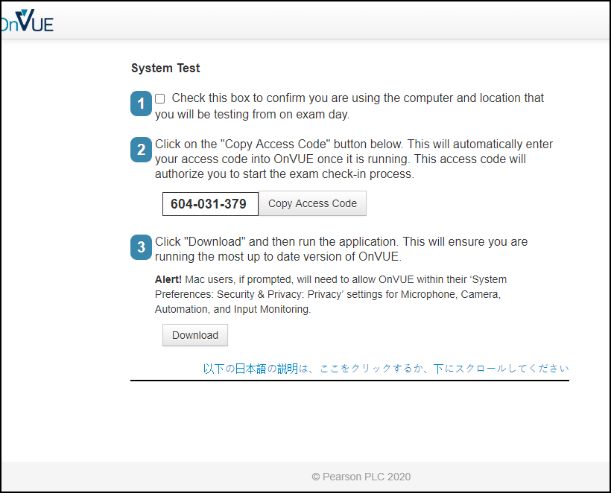

Slide 50
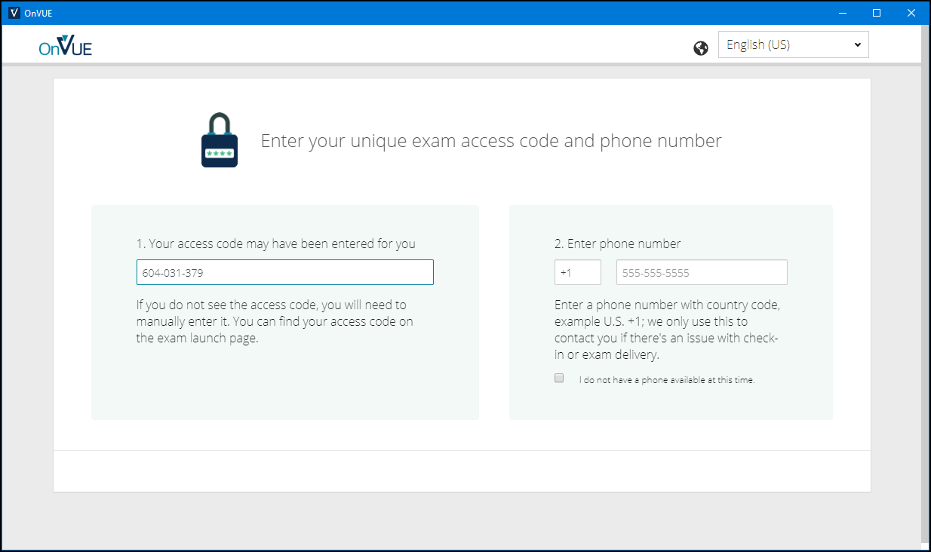

Slide 51
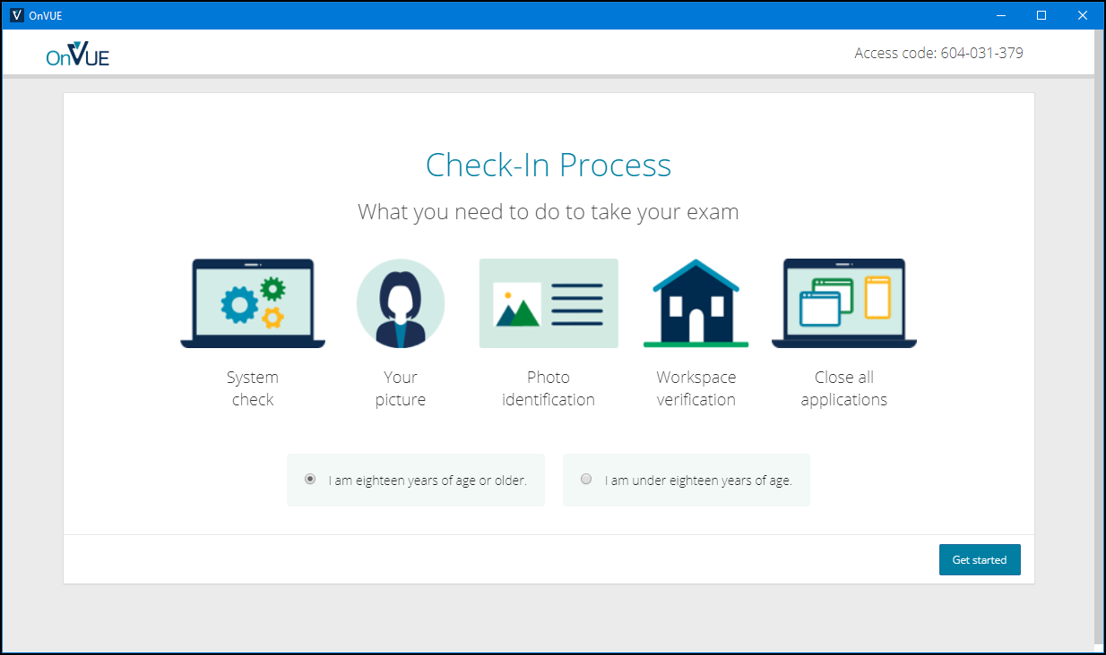

Slide 52
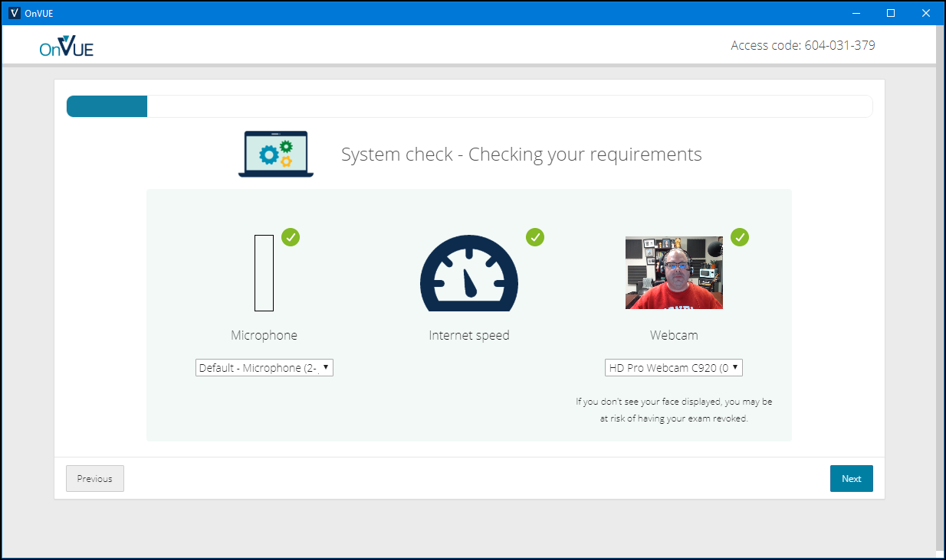

Slide 53
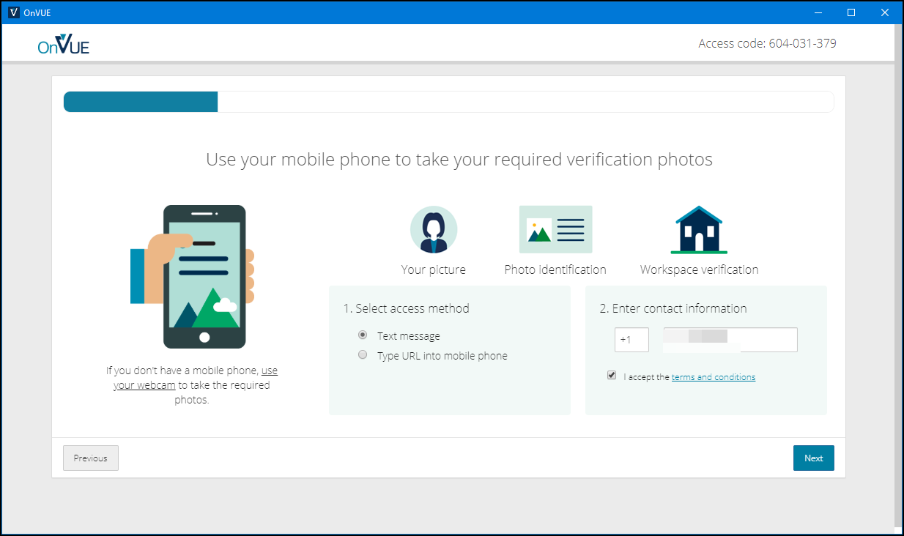

Slide 54
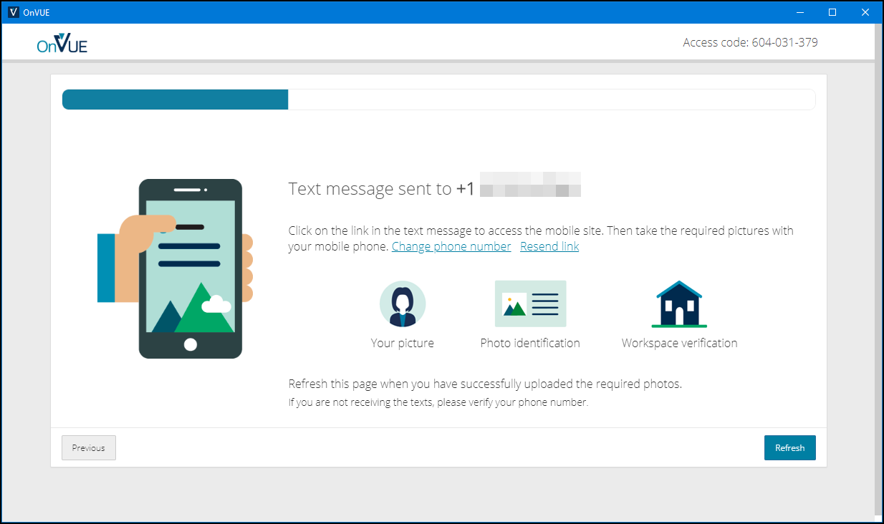

Slide 55
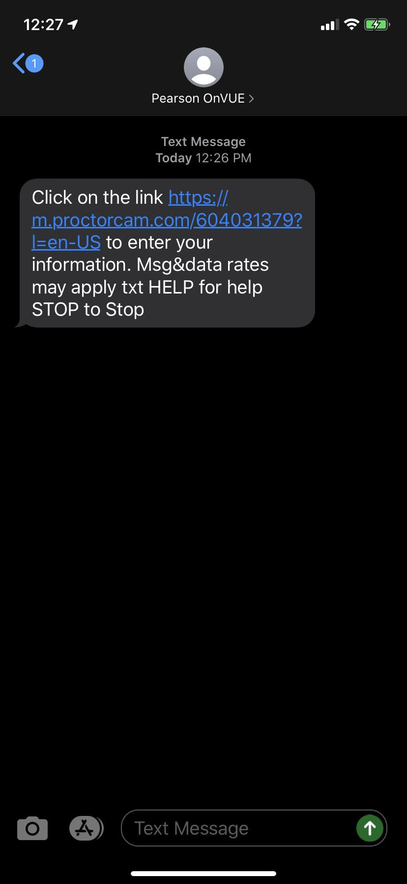
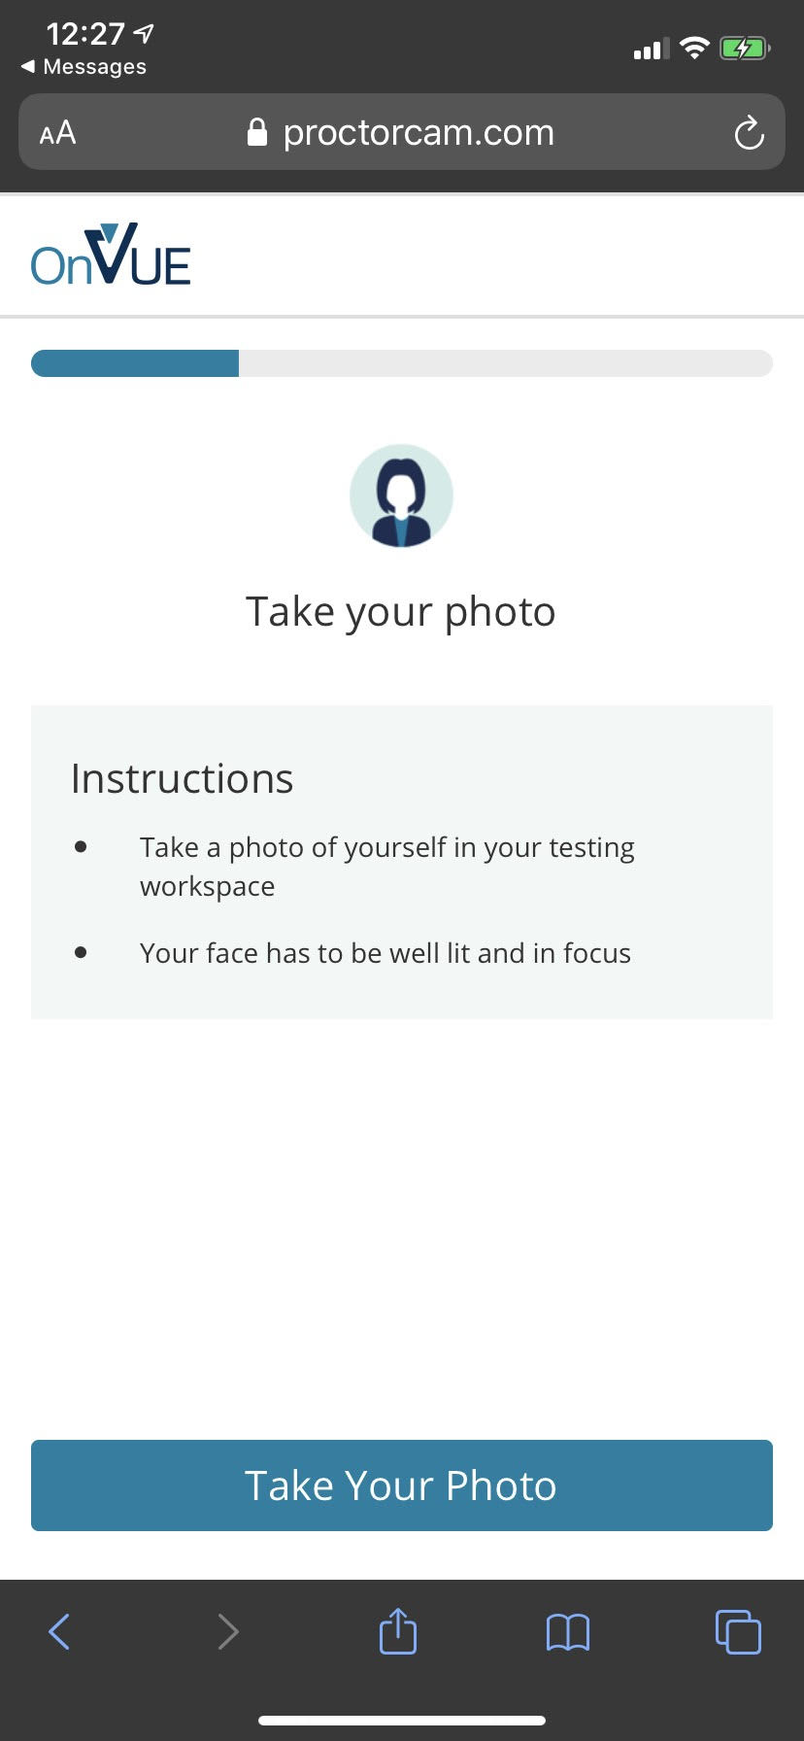
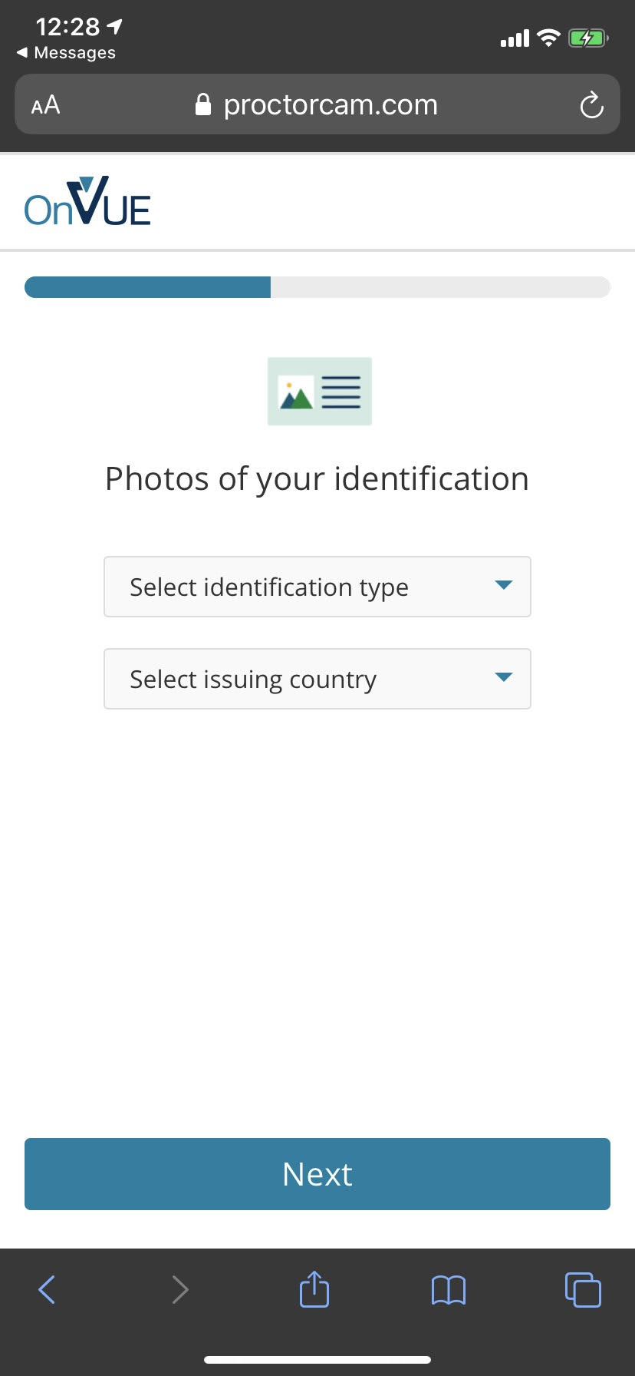

Slide 56
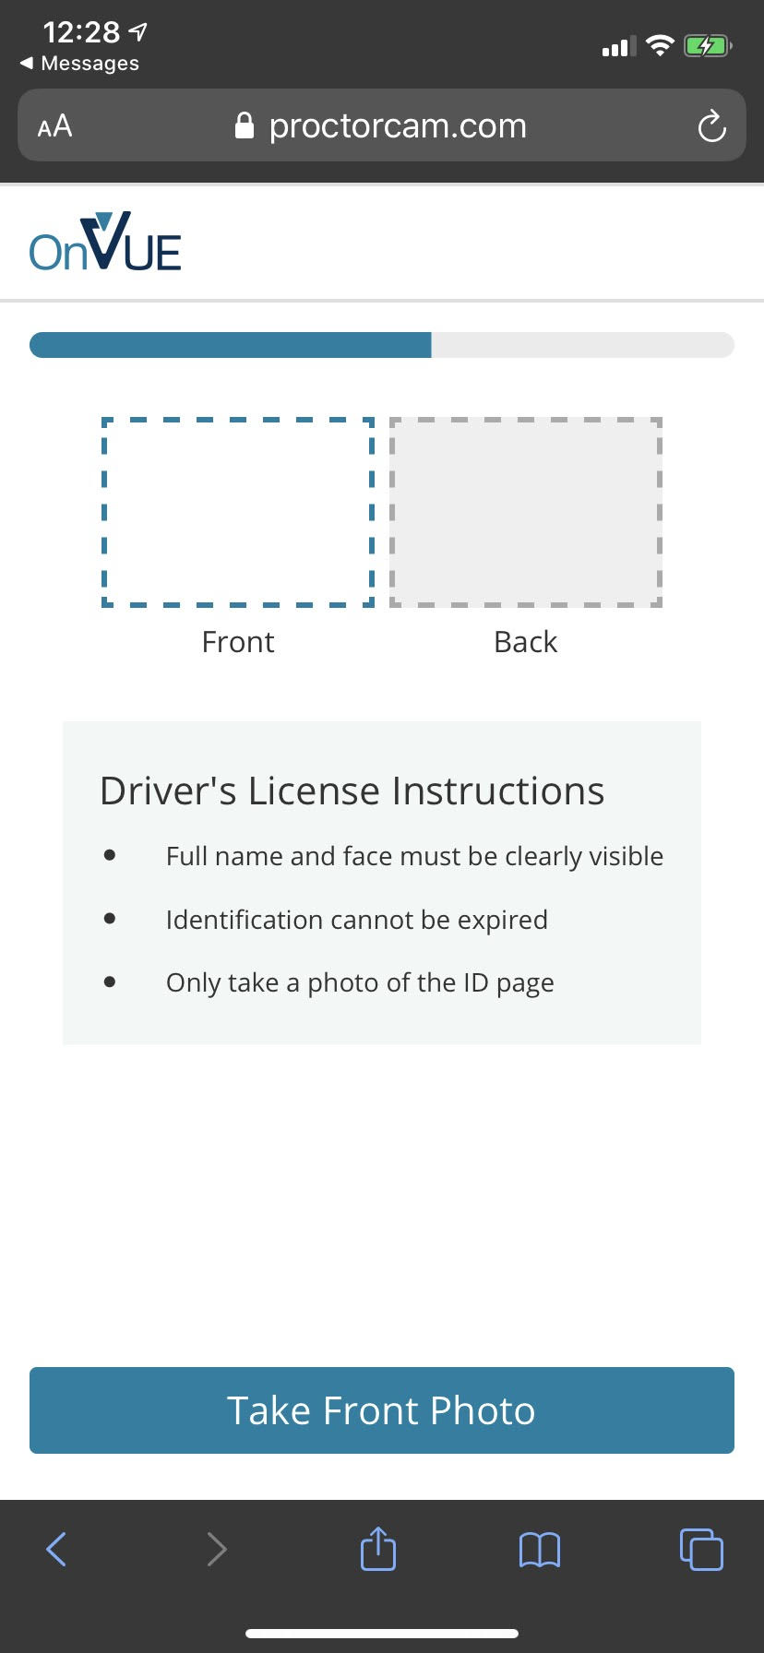
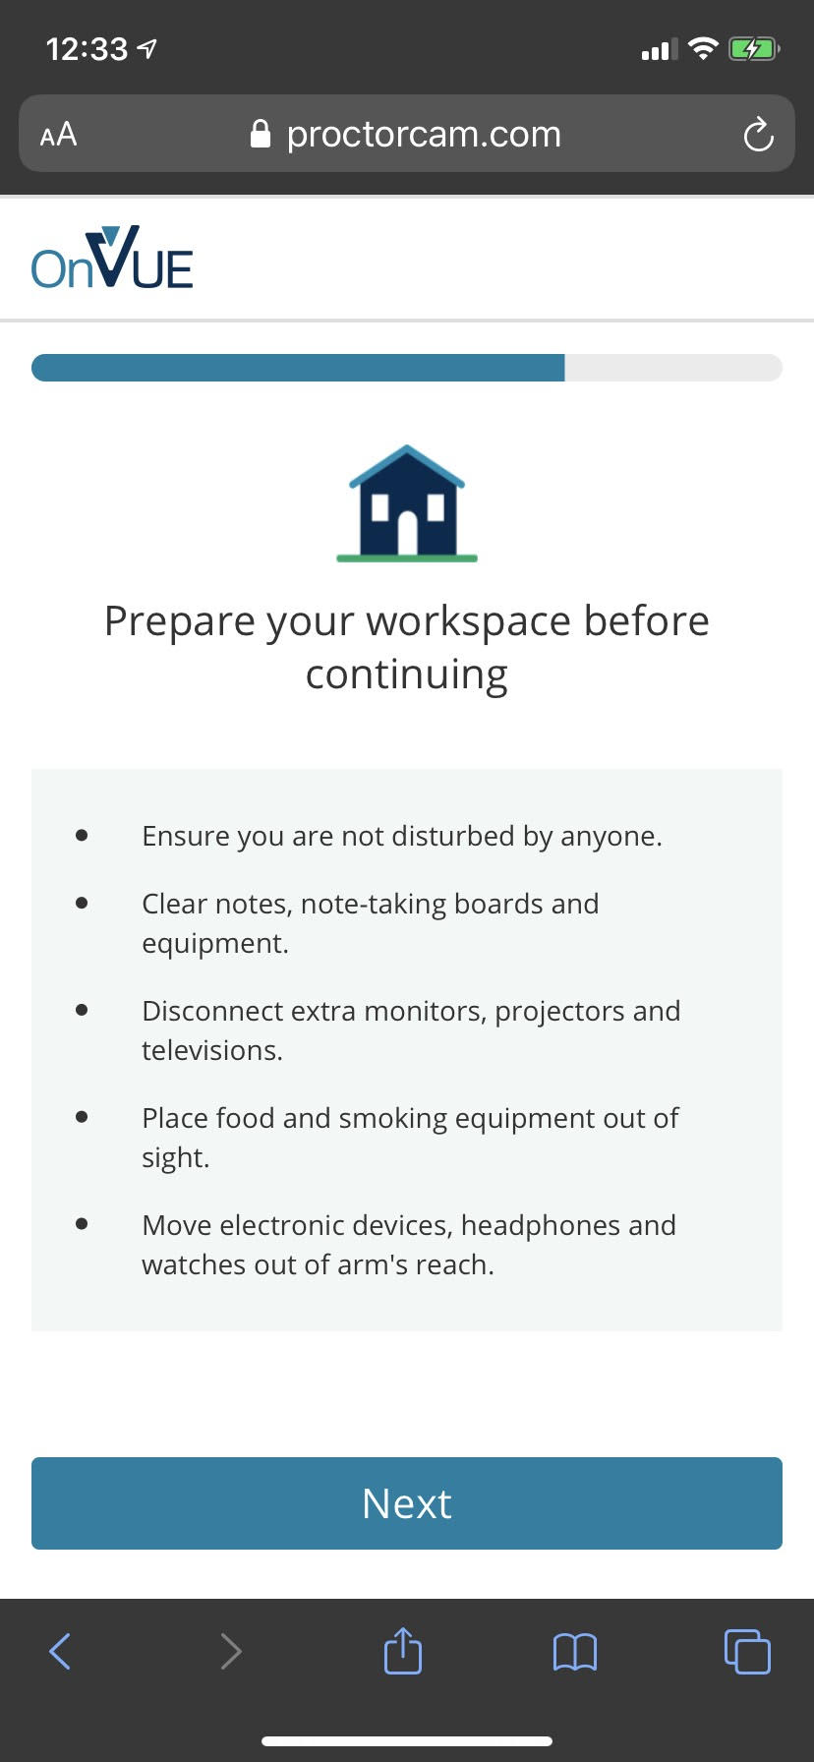

Slide 57
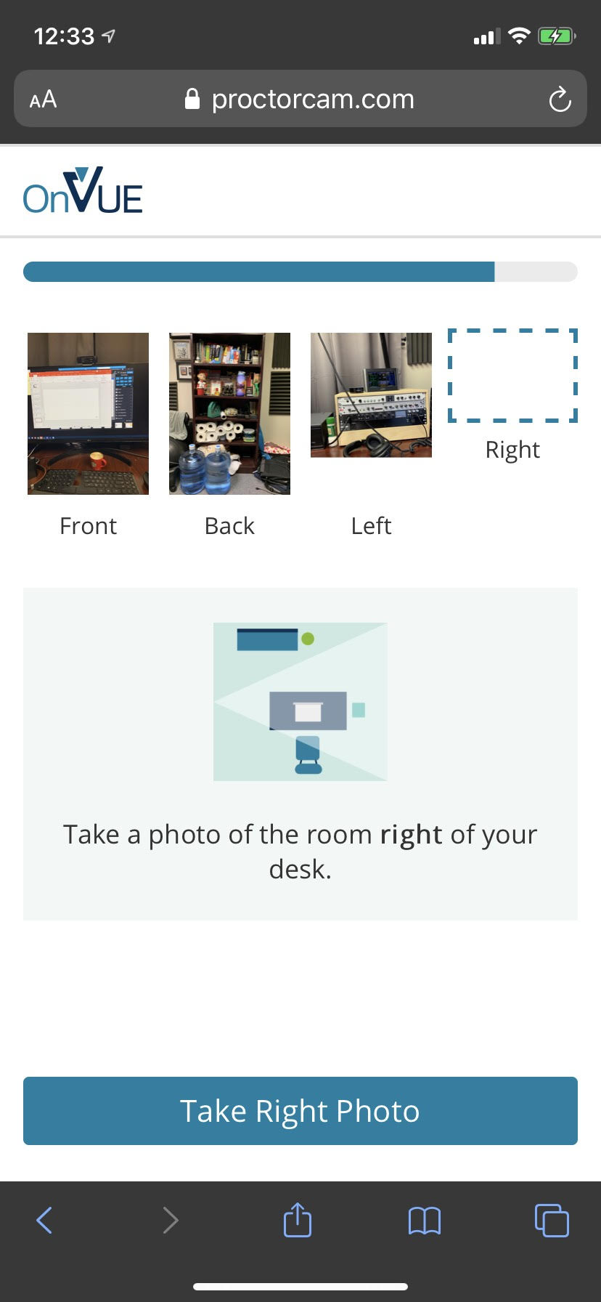
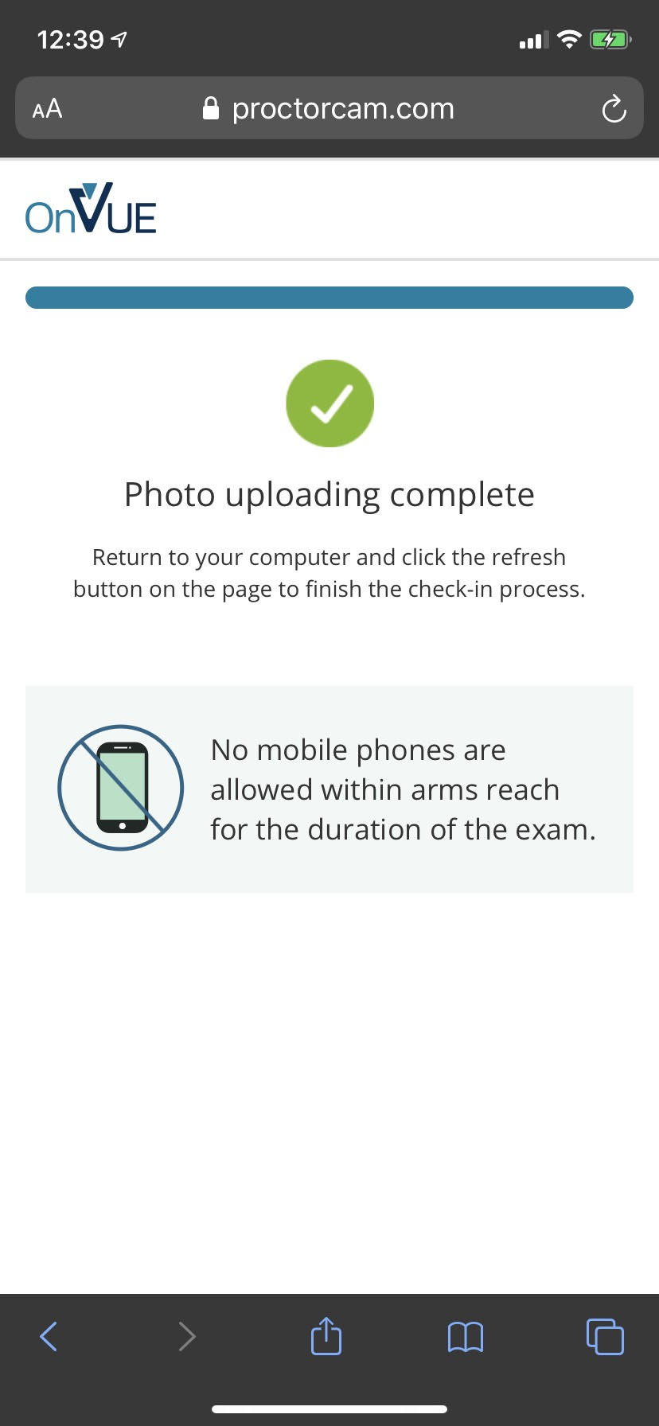

Slide 58
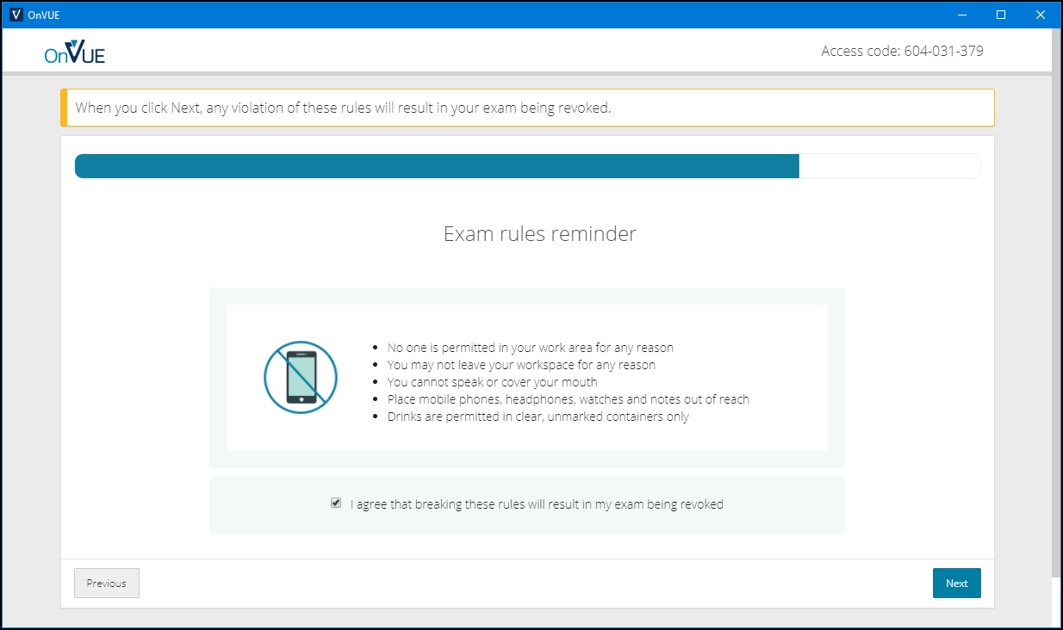

Slide 59
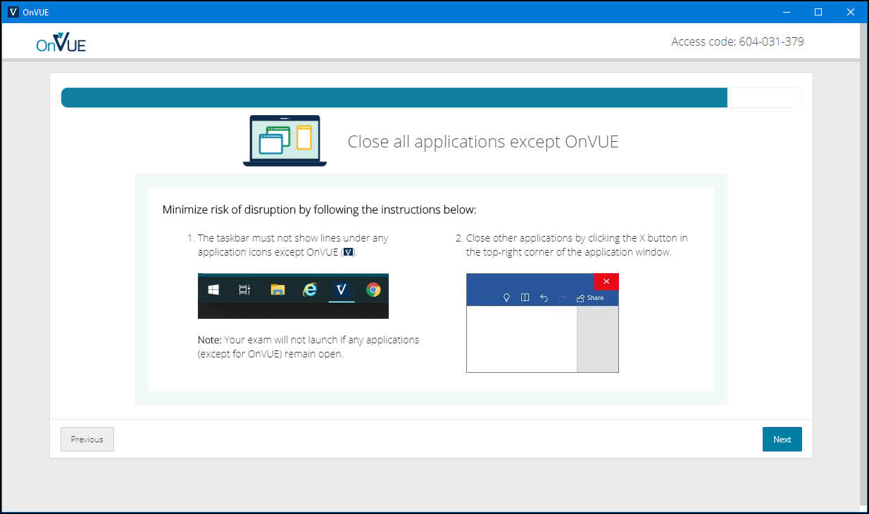

Slide 60
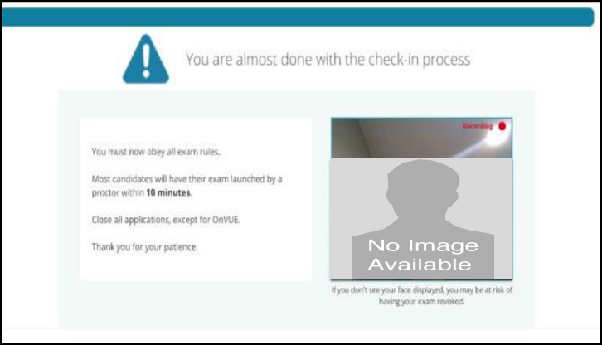

Slide 61
AZ-400 Exam Tips
Expect to see a lot of JSON, PowerShell, and Azure CLI
Expect NOT to see C# or JavaScript
It doesn't matter which exam order you use:
AZ-203
AZ-103/AZ-104
AZ-400
Perform due diligence in validating your environment for Microsoft online testing

Slide 62
Thank you!
Course materials: timw.info/az400
Twitter: @TechTrainerTim
Work: timw.info/ps
Web: TechTrainerTim.com

Slide 63
Exam AZ-400 Exam Strategy

Slide 64
Tim's Certification Study Pyramid
Interdependence
Content knowledge
Practical application
Test-taking skills

Slide 65
AZ-400 Item Types

Slide 66

Single Answer Multiple Choice

Slide 67
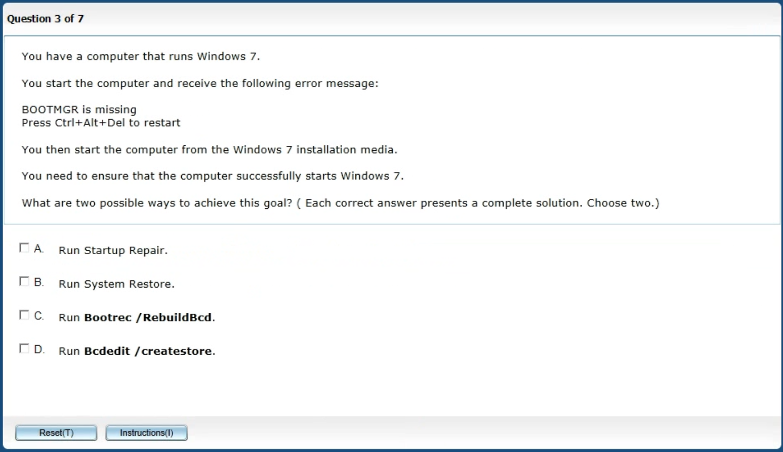
Multiple Answer Multiple Choice

Slide 68
Repeated Scenario
You need to move an Azure VM to another hardware host.
Solution: You redeploy the VM.
Does this solution meet the goal?
Yes
No

Slide 69
Repeated Scenario
You need to move an Azure VM to another hardware host.
Solution: You restart the VM.
Does this solution meet the goal?
Yes
No

Slide 70

Select and Place

Slide 71

Build List and Reorder

Slide 72

Active Screen/Fill in the Blank

Slide 73

Case Study

Slide 74






Performance-Based Lab

Slide 75
Preparing for Online Testing

Slide 76
Why Microsoft Online Testing?
COVID means Pearson VUE physical testing centers are unavailable
The Pearson OnVUE client has come a LONG way
I'll use online testing exclusively from now on

Slide 77
Pearson OnVUE System Requirements
Windows 10 / Windows 8.1
macOS High Sierra (10.13)
4 GB RAM
1024x768/16 resolution
1920x1080/32 recommended
Touchscreens are prohibited

Slide 78
Pearson OnVUE System Requirements
3 Mbps down/up network bandwidth
Mobile hotspot tethering is prohibited
Browsers:
IE 11, Edge, Chrome, Firefox, or Safari (latest versions)

Slide 79
Pearson OnVUE System Requirements
Webcam: 640x480/10 fps
Microphone: integrated
Headsets not allowed
Corporate VPNs, firewalls, and proxies will likely disrupt the delivery
Check with networking team first

Slide 80
Your Pre-Exam Checklist
Computer set up
Kill all tasks except for your browser
May need to use Task Manager or Activity Monitor
Additional monitors turned off
Mobile phone
ID

Slide 81
During the Exam
Keep your face in the webcam frame
Keep your hands away from your mouth
Ensure you aren't interrupted
Walled room
Door closed
No bio breaks are allowed

Slide 82
Demo
asdf

